Slide 1
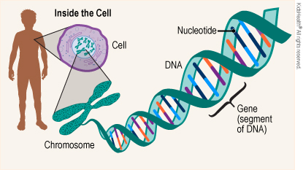
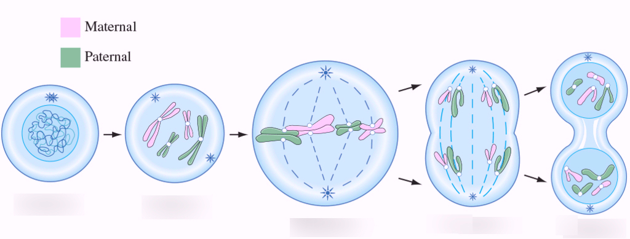
Year 10 Biology Revision
Name: _______________________________
DNA
Q1: What does DNA stand for? ____________________________________________
Q2: Name the four bases: A__________________ C_____________________
T__________________ G_____________________
Q3: Name the items labelled in the diagram:
Q4: What are the three parts of a nucleotide?
S__________________ P_____________________ B_________________
Q5: In a certain gene in an organism, 20% of the nitrogenous bases are adenine. How many are guanine? Justify your answer.
Answer _________________
Justification ________________________________________________________________
_____________________________________________________________________________
Deoxyribonucleic acid
(1)
denine
ytosine
(4)
hymine
uanine
(4)
Cell
D
A _______________________
B _______________________
C DNA
D _______________________
E _____________________
A
C
Chromosome
E
Nucleotide
B
Gene
ugar
hosphate group
ase
(3)
(2)
30%
A pairs with T, C pairs with G (1 mark)
20% from A plus 20% from T = 40%. The 60% remaining is split between C and G. (1 mark)
Mitosis and Meiosis
Q6: How many chromosomes in a diploid human cell? ______________
Q7: What is the purpose of mitosis? _____________________________________________________
Q8: Meiosis creates gametes. What are the male and female gametes called?
_______________________________ ___________________________
Q9: What is the difference between cells created by mitosis and cells created by meiosis?
_________________________________________________________________________________
Q10: Match the stage of cell division with its picture:
Q11: Complete the sentences: parent haploid diploid chromosome four two identical unique six
Mitosis creates ___________ cells. In mitosis, a parent cell splits into _____ ____________ daughter cells. Meiosis creates __________ cells. In meiosis, a parent cell splits into ________
____________ daughter cells.
46
Growth and repair
(1)
(1)
Sperm cells
Egg cells (ova)
(2)
Mitosis creates diploids. Meiosis creates haploids. Haploids have half the chromosomes of diploids.
(1)
Prophase Metaphase Anaphase Telophase
(4)
____________
____________
____________
____________
Prophase
Interphase
Anaphase
Metaphase
Telophase
diploid
two
identical
(3)
unique
haploid
four
(½ a mark each)

Slide 2
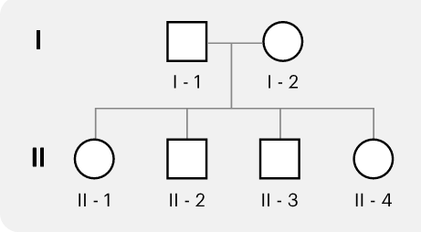
Inheritance
In guinea pigs, red eyes (R) is dominant over black eyes (r).
Q12: What is the phenotype of a guinea pig with the genotype: Rr _________________
rr _________________
Q13: A black-eyed female mated with a homozygous dominant male guinea pig.
What is the genotype of the female? _____________
What is the genotype of the male? _____________
Complete the Punnett Square.
What is the probability that their offspring would have black eyes?
_______________________________________
Red eyes
(1)
Black eyes
(1)
(5)
rr
R R
RR
Rr
Rr
r
Rr
r
Rr
0%
(2 marks for completely correct)
Sex-linkage and Pedigrees
Q14: What are the sex chromosomes of a typical human female? ___________
Q15: Sex-chromosomes are also known as autosomes. True or False? ___________
Q16: Explain why males are more susceptible to sex-linked traits than females?
_________________________________________________________________________________
_________________________________________________________________________________
Q17: Haemophilia is a sex-linked recessive trait. A female carrier mated with a non-affected male.
What is the genotype of the female? _______________
What is the genotype of the male? _______________
Complete the Punnett Square
What is the probability that their son would have haemophilia? _________
What is the probability that their daughter would have haemophilia? _____
Q18: A geneticist studying haemophilia created this pedigree.
What does a circle represent? _____________
Which individuals are affected by haemophilia? __________________
Individual I-2 is a carrier for haemophilia. How do we know that?
_________________________________________________________
XX
(1)
False
(1)
(2)
Sex-linked traits are on the X sex chromosome (1 mark). As males only inherit one X chromosome, they will exhibit the recessive trait if they inherit a single recessive allele from their mother. (1 mark)
(6)
X^{H}X^{h}
X^{H} Y
X^{H}Y
X^{H} X^{H}
X^{H} Y
X^{H}
50%
X^{H} X^{h}
X^{h} Y
X^{h}
0%
(3)
female
II-2 and II-3
She does not have haemophilia but her sons do
Topic | My score | Total | Percentage
DNA |  | 14
Mitosis and meiosis |  | 12
Inheritance |  | 7
Sex-linked traits and pedigree |  | 13
Total |  | 46

